Slide 1
B
OGM A
OGM A
A
D
OGM A
C
OGM A

Slide 2

TQ_{A}=255
TQ_{A’}=255*TQ_{BA}
TQ_{A”}=TQ_{A’}*TQ_{CB}
A
B
C
D
TQ_{BA}
TQ_{CB}
TQ_{DC}

Slide 3
B
D
A
F
C
E

Slide 4
1
2
3
4
5
1
2
3
4
5

Slide 5
1
4
2
3

Slide 6
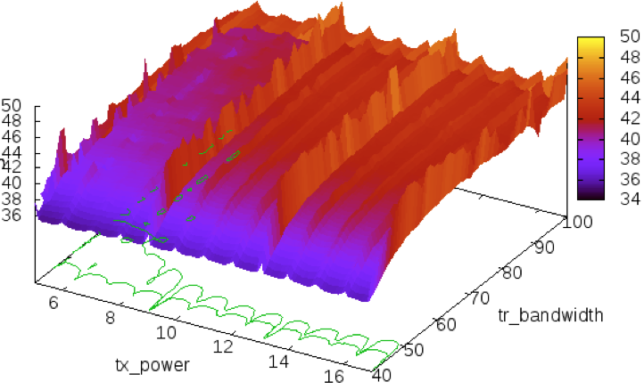
real bandwidth

Slide 7
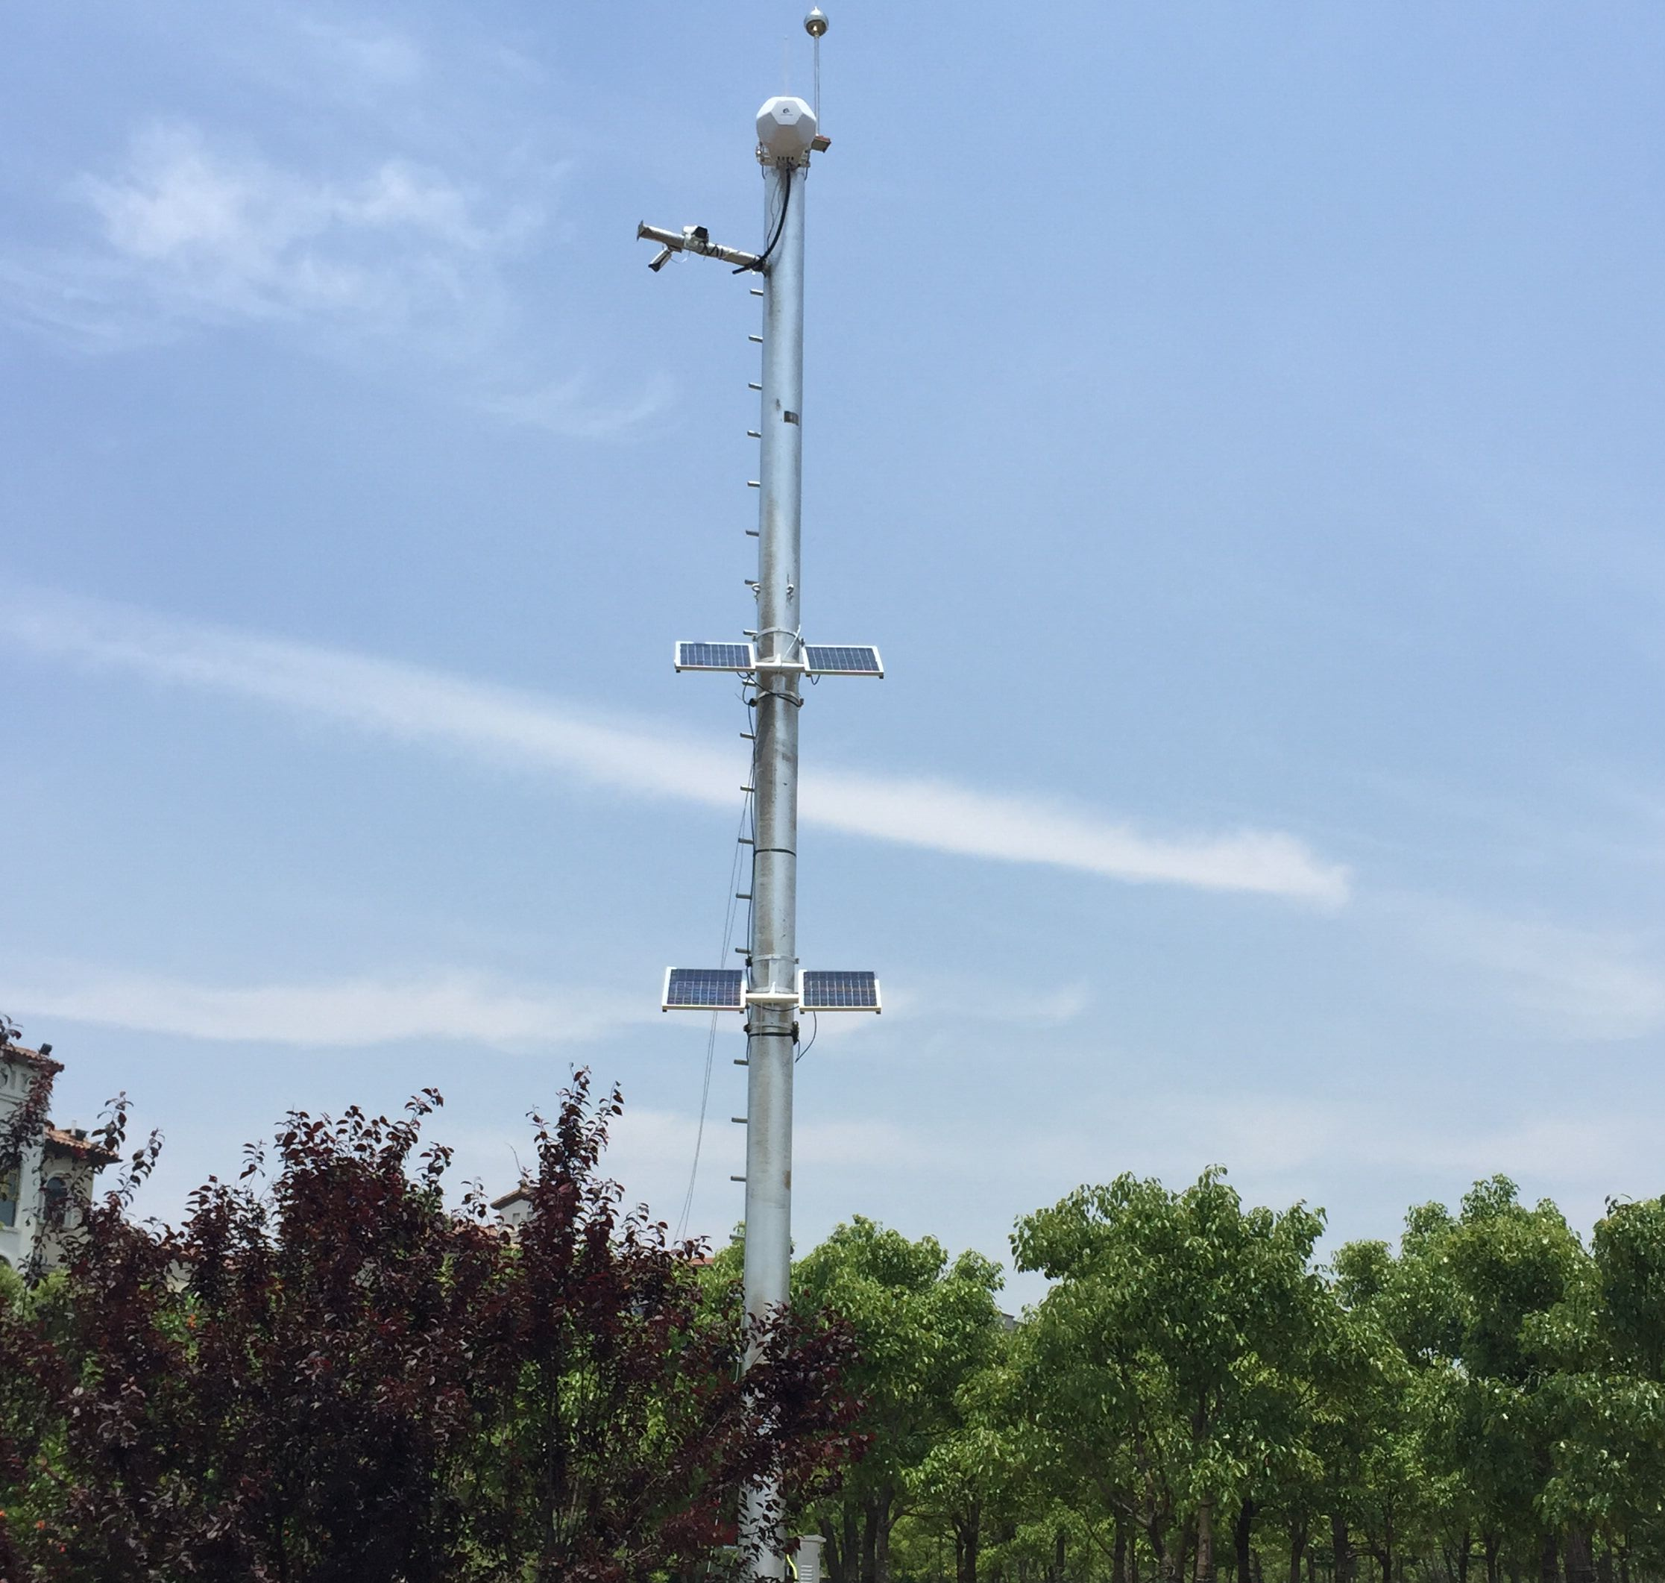
Mesh节点
摄像头
太阳能供电板

Slide 8
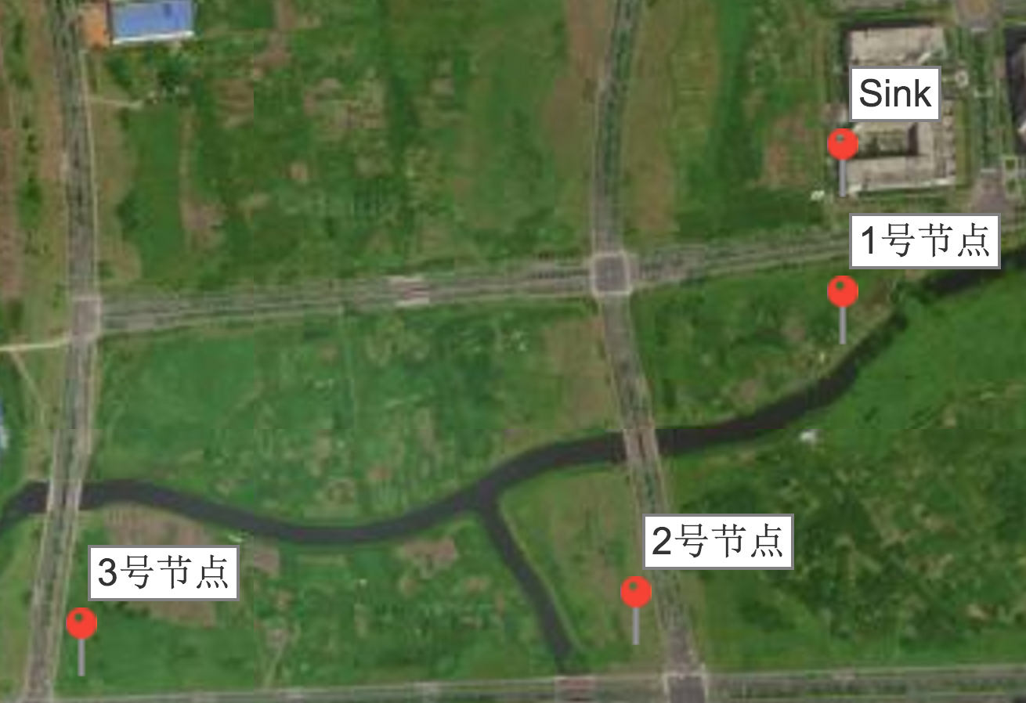

Slide 9
Cluster_1
Cluster_2
channel_153
channel_157
Cluster_10
channel_142
channel_142
Cluster_3
channel_161
Cluster_9
channel_149
channel_149
Cluster_4
Cluster_8
channel_153
channel_153
Cluster_5
Cluster_6
Cluster_7
channel_157
channel_157

Slide 10
1
2
3
cli
moves
cli

Slide 11
OGM(6)
OGM(6)
OGM(6)
OGM(6)
OGM(6)
1
2
3
4
5
6
cli
cli
moves

Slide 12
Ext
Ext
Ext
data
data
data
C
C
C
data
data
data
A
B
A
B
A
Roming packet
B
data
data
data
cli
cli
cli
cli
(a)
(b)
(c)
Ext
Ext
Ext
data
data
data
C
C
C
data
data
data
OGM
A
data
B
A
B
A
B
data
data
data
data
cli
cli
cli
(d)
(e)
(f)

Slide 13
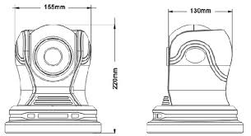
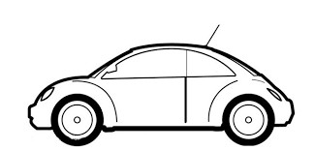
E
D
C
B
A
3
2
1
4

Slide 14
2
1
4
3

Slide 15
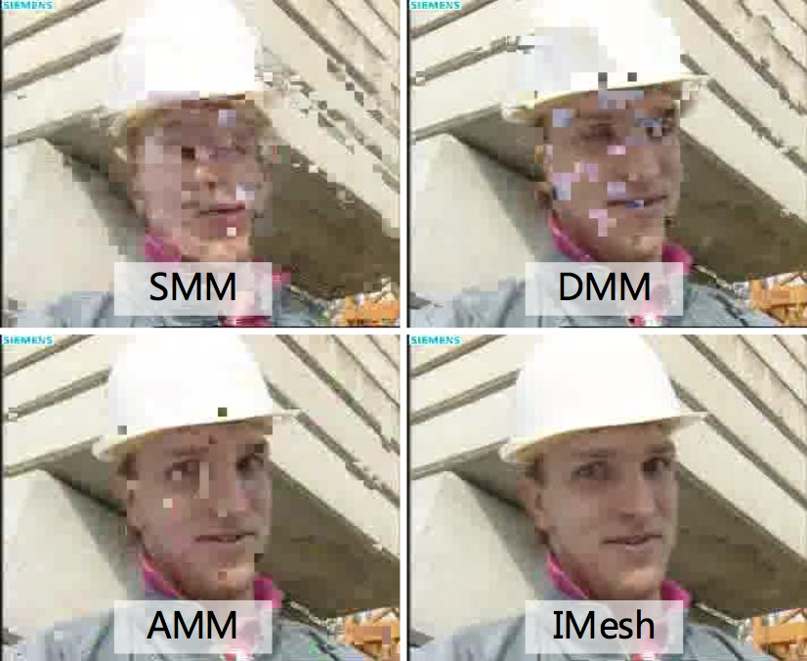
SMM
DMM
AMM
MeshMapping

Slide 16
网络层
虚拟Mesh网络接口
BATMAN-adv
虚拟网络层接口
MAC层

Slide 17
dynamic_threshold.c
rx
hard-interface.c
rx
routing.c
rx
rx
fwd
soft-interface.c
tx
fwd
tx
tx
send.c
unicast.c
tx
translation-table.c

Slide 18
translation_table.c
transtable_search
soft-interface.c
interface_tx
unicast.c
unicast_send_skb
routnt.c
find_router
send.c
send_skb_packet

Slide 19
外部异构网络
Mesh 路由器＋网关
Mesh 路由器＋网关
Mesh
路由器
Mesh路由器
Mesh 客户端
Mesh 客户端
Mesh 路由器
Mesh 客户端
Mesh
路由器
Mesh 客户端
Mesh 客户端

